Slide 1
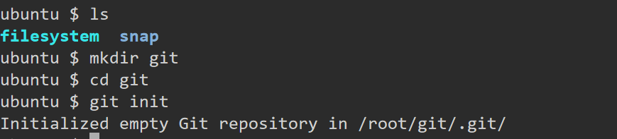
How to create local repository
What is GIT[local repository], how to create local repository
>>> create one directory[mkdir <directoryname> ; cd <directoryname> ] then run "git init" command

Slide 2
How to create remote repository in GIT
Create a Repository on GitHub:
Log in to your GitHub account.
Click on the "+" icon in the upper right corner and select "New repository".
Fill in the repository name, description (optional), and choose whether it should be public or private.
Click "Create repository".

Slide 3
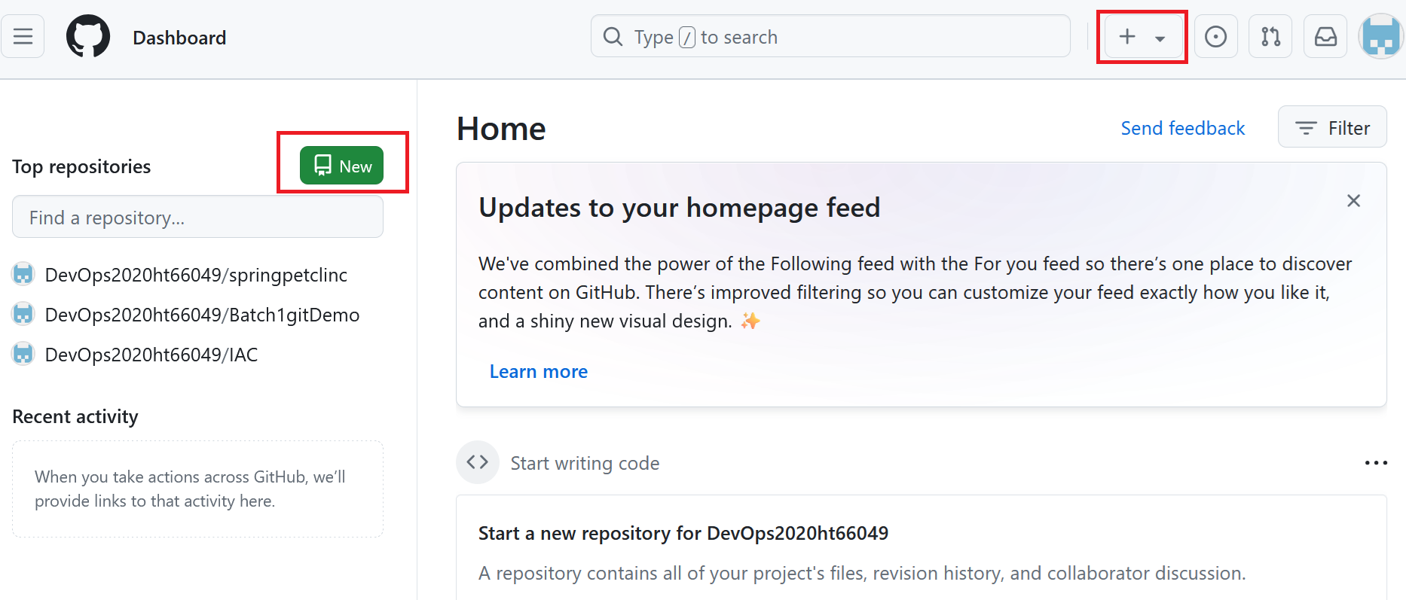

Slide 4
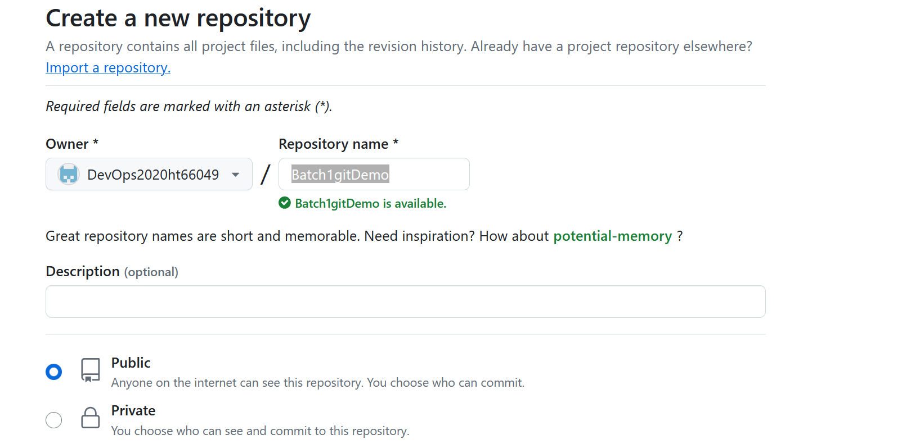

Slide 5
Local to remote communication
We need to generate token for it.
Token based authentication: https://docs.github.com/en/authentication/keeping-your-account-and-data-secure/managing-your-personal-access-tokens
Please follow above steps to generate token, please see next step and generate classic token only.

Slide 6
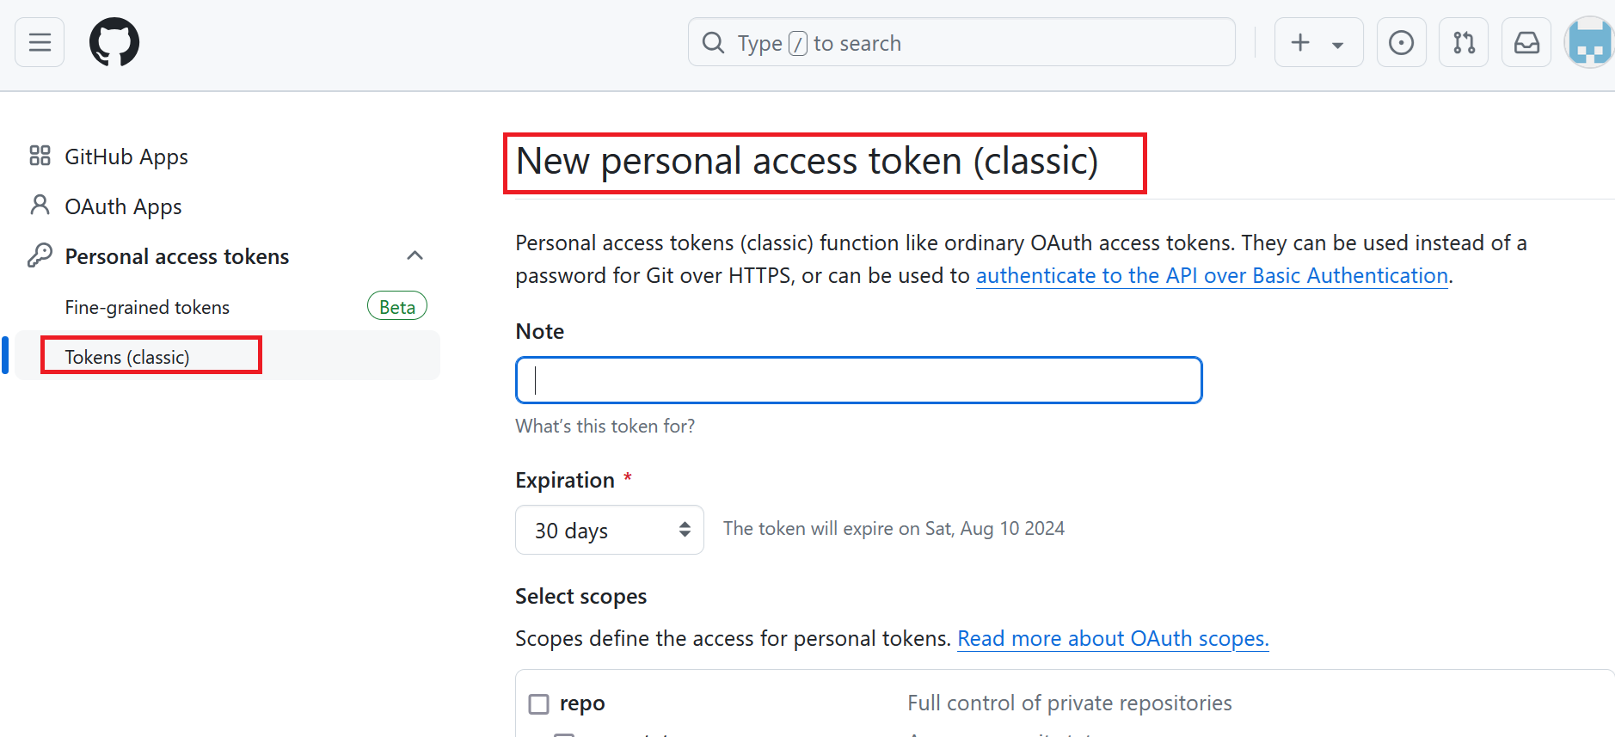

Slide 7

Sample token
ghp_ABCDEFGHIJKLMNOPQRSTUVWXYZ

Slide 8
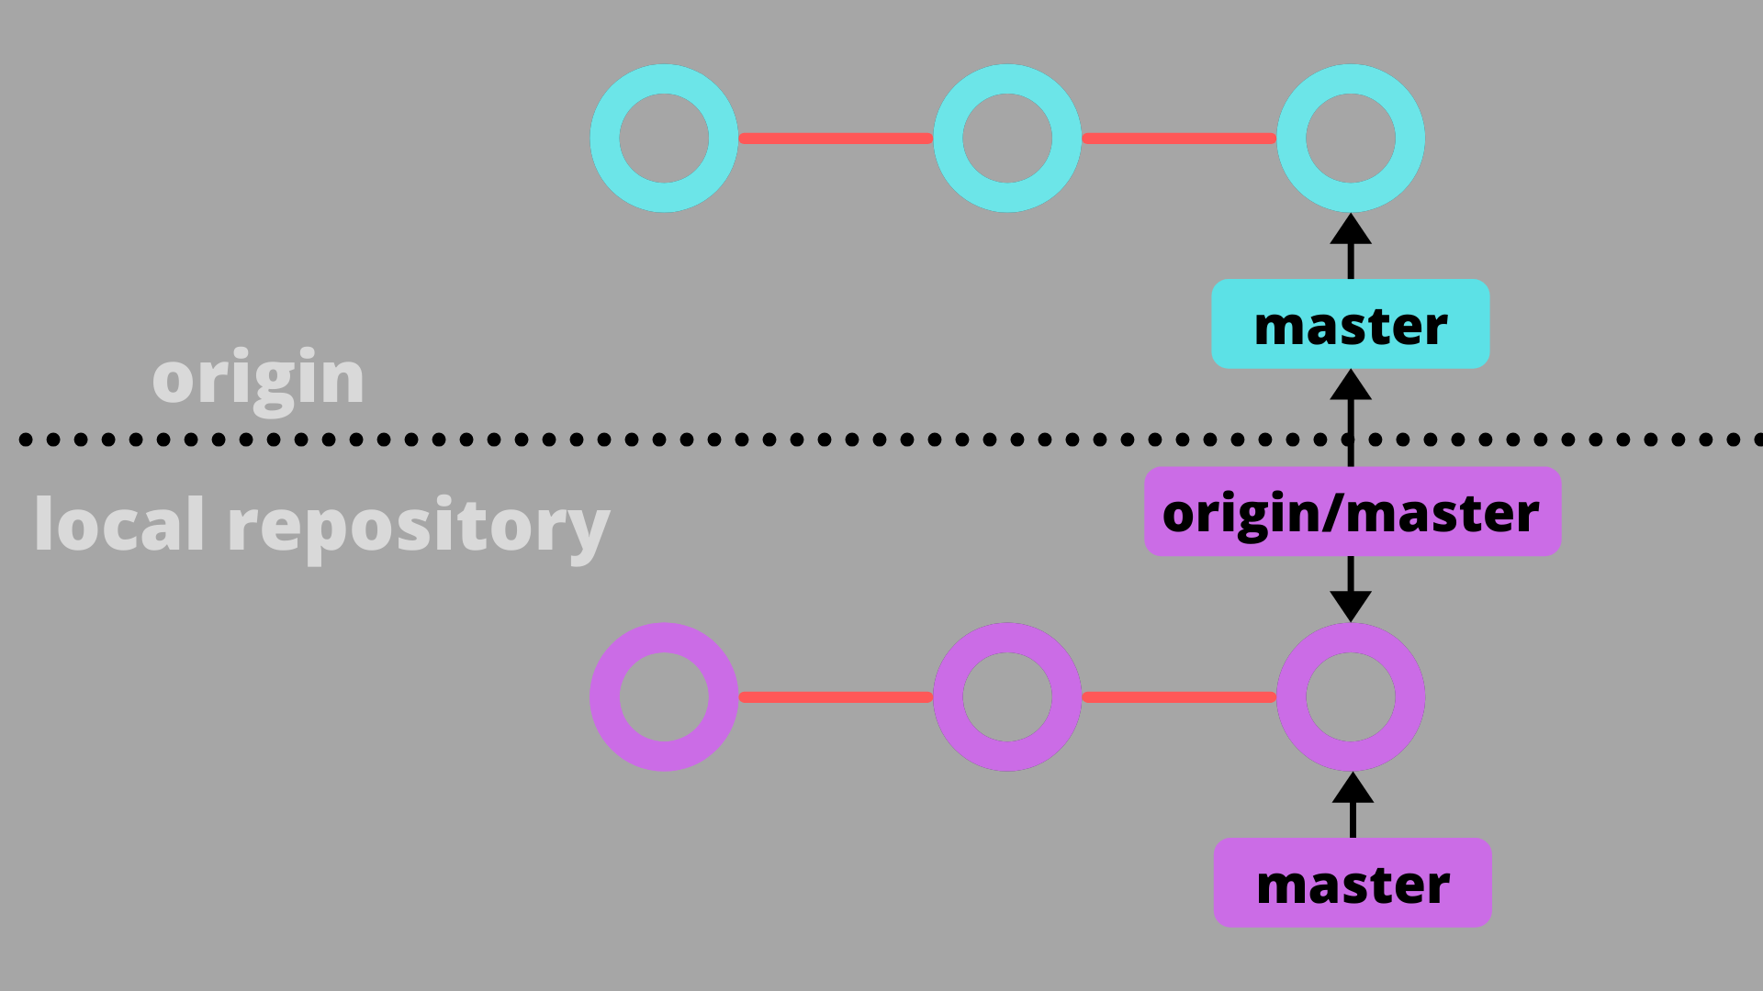
Command to establish connection
git remote set-url origin https://<GITHUB_ACCESS_TOKEN>@github.com/<GITHUB_USERNAME>/<REPOSITORY_NAME>.git

Slide 9
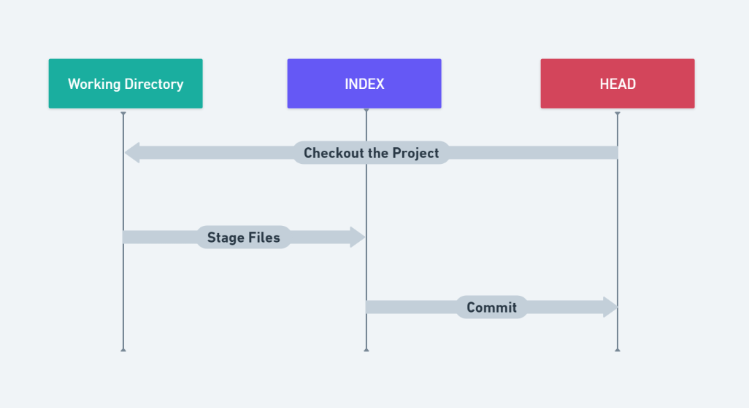
Working tree in GIT

Slide 10
Command to push the change from local to remote
git add
git commit -m “message”
git push

Slide 11

What is VCS
It’s a mechanism to track the file change details

Slide 12
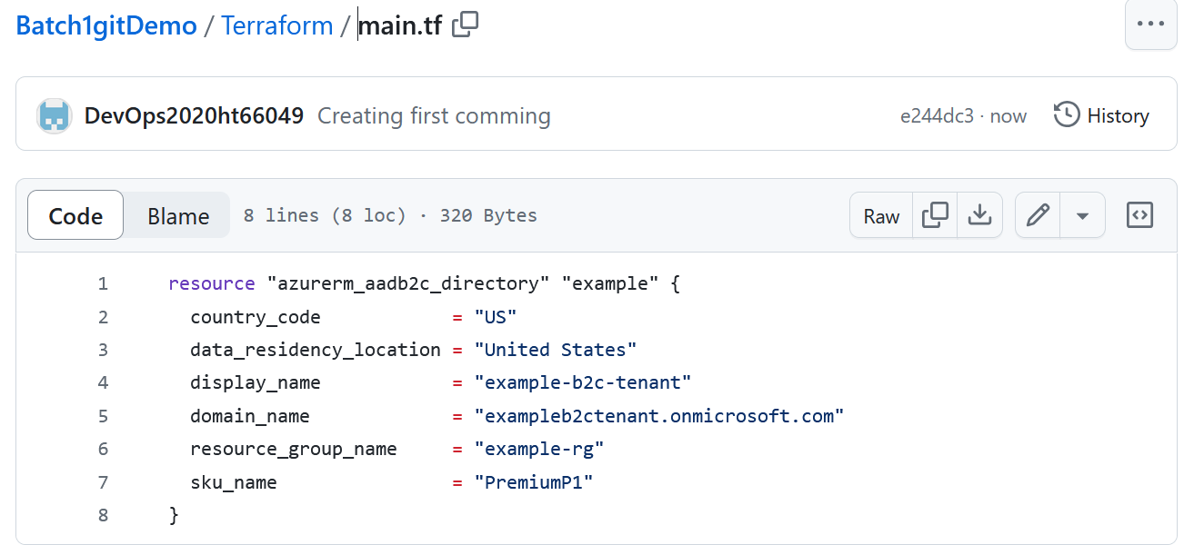

Slide 13
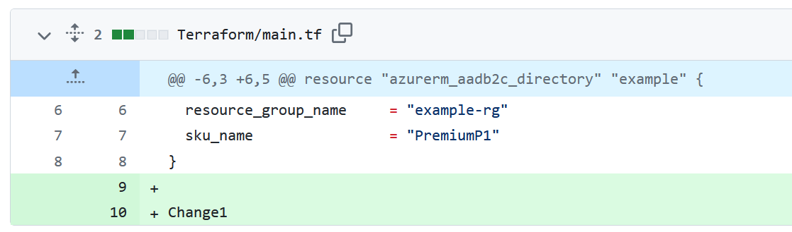

Slide 14
